Slide 1

THE FIRST NIGHT OF CHRISTMAS
Matthew 2:13-24
Pastor Road M. Lago

Slide 2
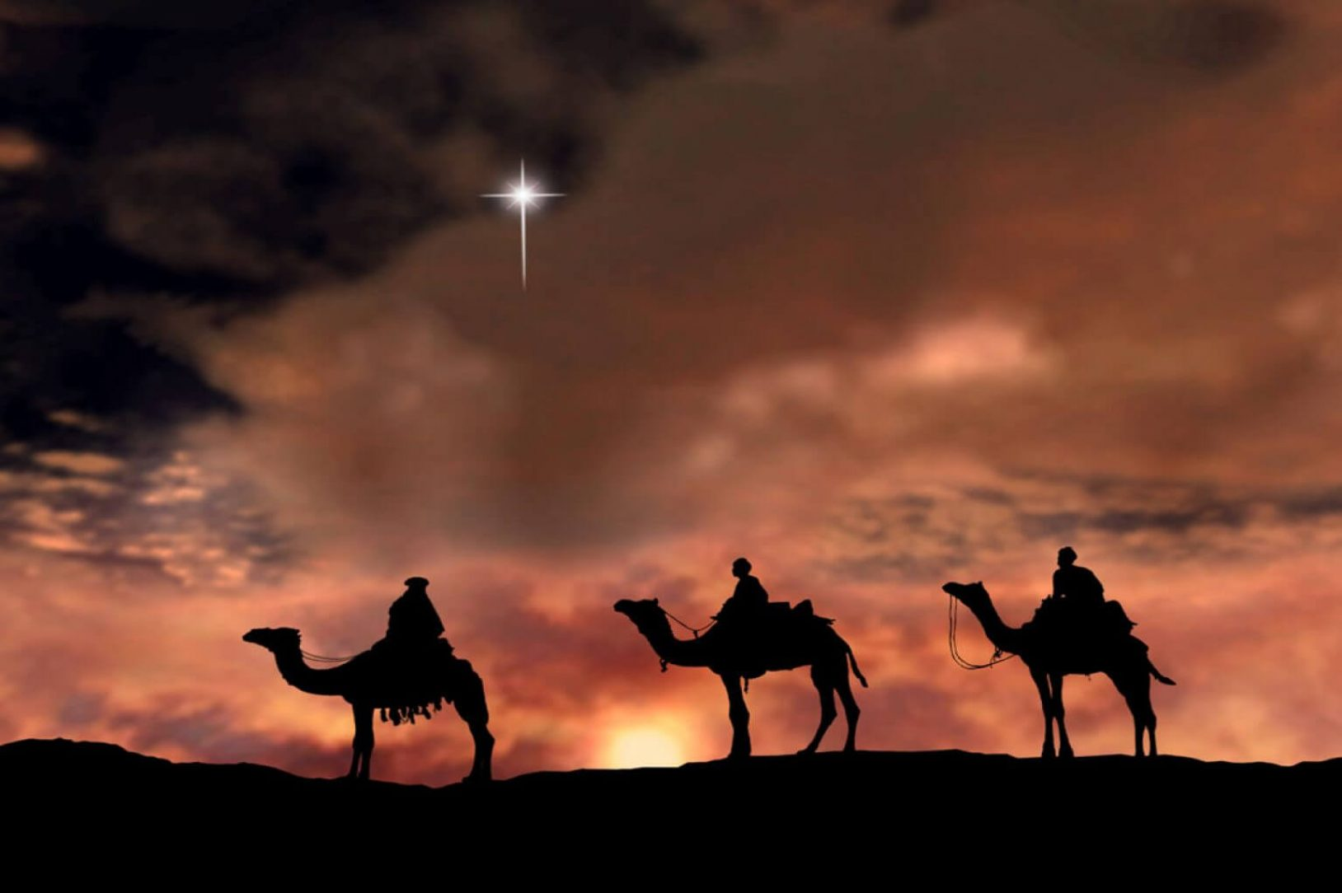
I. FULL OF HASSLE v.13-15

Slide 3
II. FULL OF HEARTACHES v.16-18

Slide 4
III. FULL OF HOPE v.19-23

Slide 5
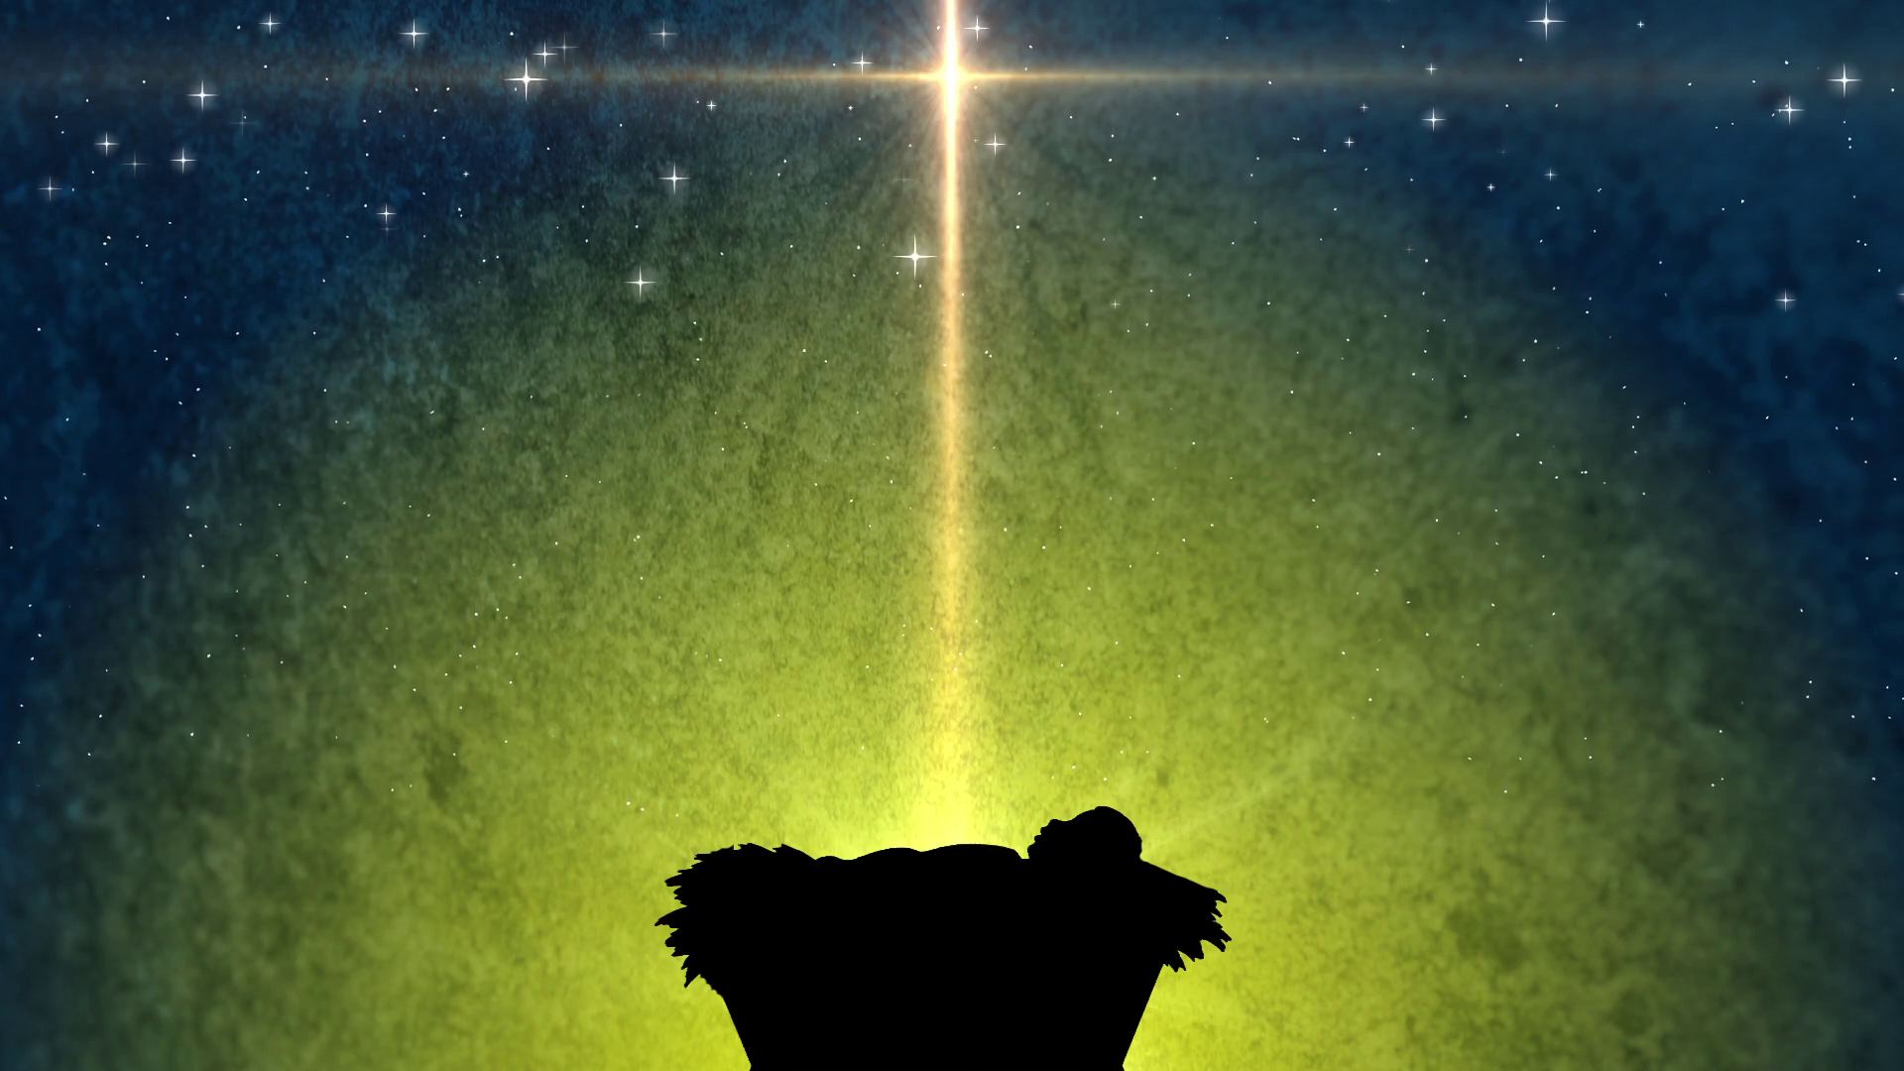
JESUS means Savior

